Slide 1
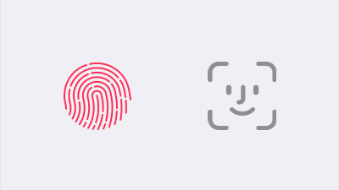
Apple's Biometrics
William Chen
Professor Christopher Croad
IST 323 - M002

Slide 2
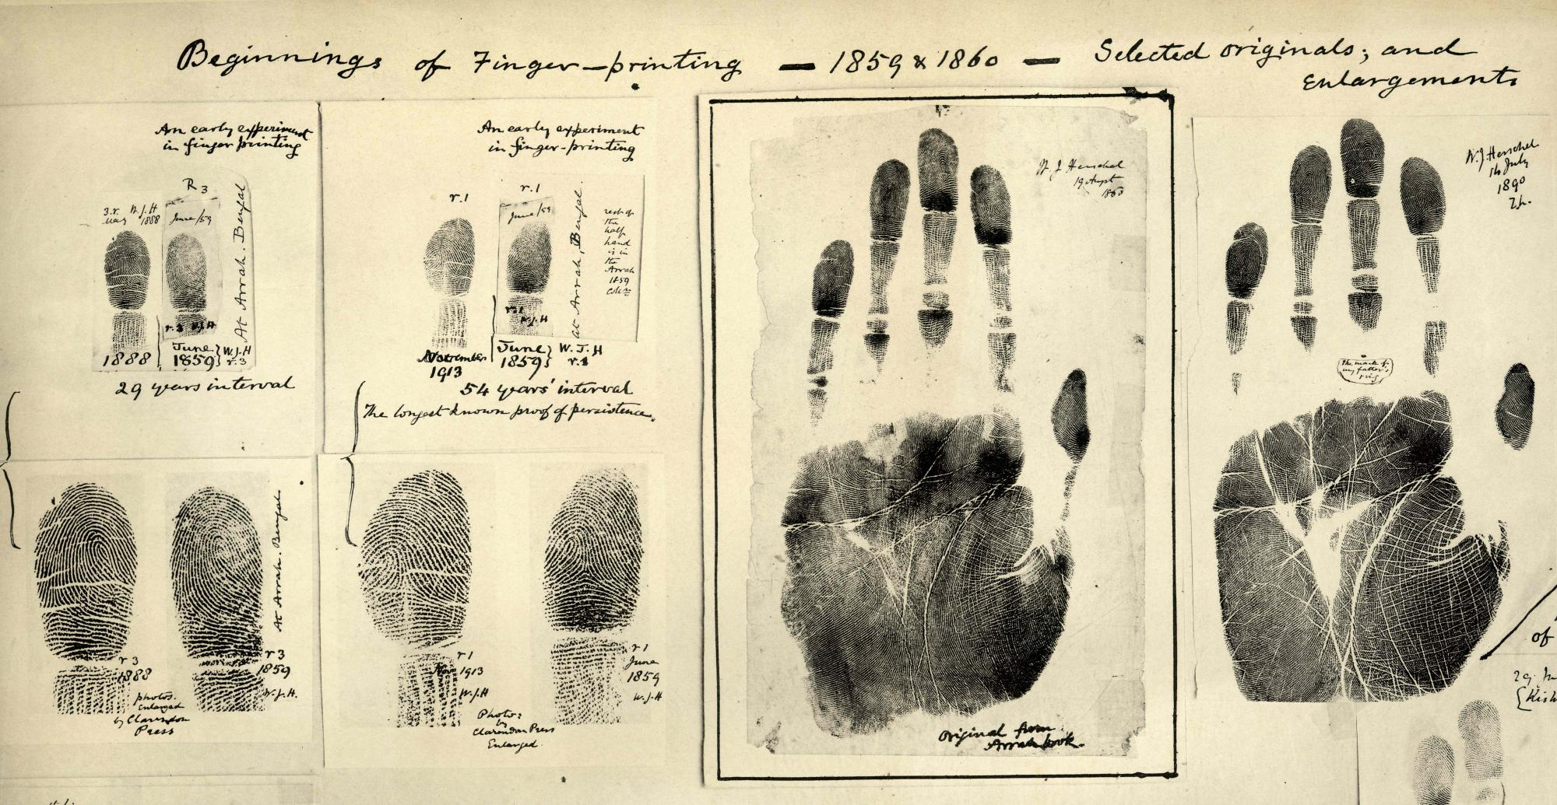
What is Biometrics?
Biometrics are unique physical characteristics such as fingerprints
Can be dated back to as early as 500 BC in the Babylonian empire
Biometric identification started in the 1800s in Paris by Alphonse Bertillon
In the 1880s, fingerprints were used to identify criminals and as a form of a signature on contracts

Slide 3
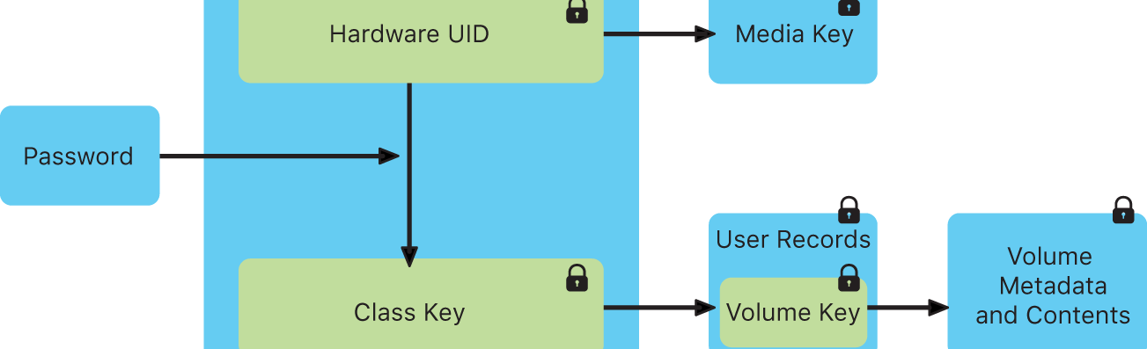
Secure Enclave
A secure coprocessor that includes a hardware-based key manager, which is isolated from the main processor to provide an extra layer of security.
Available on many devices (starting from the iPhone 5s and later).
Unique to your device
"Stores only 256-bit elliptic curve private keys. These keys can only be used for creating and verifying cryptographic signatures...".
Only works on the local device.

Slide 4
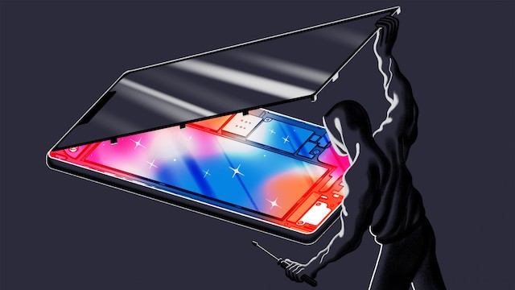
Secure Enclave Problems
In 2017, a hacker named xerub released a decryption key for Apple's secure enclave processor (SEP)
Decrypted the firmware but failed to get access to the private keys
An anonymous Apple employee said that access to the firmware doesn’t provide access to the protected information, and it only makes research into the structure of the SEP possible.
In August of 2020, a jailbreak group known as Pangu found a weakness in the hardware
Able to combine the SEP memory and the main processor memory

Slide 5
Touch ID
Touch ID was released on the iPhone 5S in 2013
Used to unlock, authenticate, and purchase
Home button is made of laser-cut sapphire crystal and features a stainless-steel detection ring
Uses capacitive touch to detect the users' fingerprint
Reads from the subepidermal layers of your skin
Improves with every use
Creates a mathematical representation of your fingerprint
"It isn't possible for someone to reverse engineer your actual fingerprint image from this stored data."
Only 1 in 50,000 can fool Touch ID

Slide 6
Face ID
Face ID was released in 2017 with the iPhone X
The TrueDepth camera projects and analyzes over 30,000 invisible dots to create a depth map and infrared image of your face
Adapts to changes
Only 1 in 1 million can fool Face ID
Face ID matches against depth and awareness
Security concerns?

Slide 7
Questions?

Slide 8
References
https://www.dhs.gov/biometrics
https://bioconnect.com/a-brief-history-of-biometrics/#:~:text=While%20the%20earliest%20accounts%20of,classification%20and%20comparison%20of%20criminals.
https://climatenexus.org/climate-news-archive/science-primers/forcing-and-fingerprinting/
https://www.techrepublic.com/article/hacker-claims-to-have-decrypted-apples-secure-enclave-destroying-key-piece-of-ios-mobile-security/
https://www.howtogeek.com/339705/what-is-apples-secure-enclave-and-how-does-it-protect-my-iphone-or-mac/
https://developer.apple.com/documentation/security/certificate_key_and_trust_services/keys/storing_keys_in_the_secure_enclave
https://support.apple.com/guide/security/secure-enclave-overview-sec59b0b31ff/web
https://interestingengineering.com/hackers-spot-permanent-vulnerability-in-apples-secure-enclave
https://appleinsider.com/articles/20/08/03/security-enclave-vulnerability-seems-scary-but-wont-affect-most-iphone-users
https://www.iphoneincanada.ca/news/dev-fused-iphones-study-apple-sep/
https://blog.theodo.com/2018/04/add-touch-id-react-native-app/
https://en.wikipedia.org/wiki/Touch_ID#History
https://support.apple.com/en-us/HT204587
https://www.itbusinessedge.com/blogs/data-security/touch-id-hacked-only-48-hours-after-release.html#:~:text=Well%2C%20that%20didn't%20take,the%20phone%20went%20on%20sale.
https://www.pinterest.com/pin/523262050448678806/
https://www.compassred.com/data-journal/top-3-ways-organizations-are-leveraging-facial-recognition
https://boingboing.net/2017/11/06/interesting-video-on-how-apple.html
https://support.apple.com/en-us/HT208108
https://en.wikipedia.org/wiki/Face_ID
https://giphy.com/explore/send-in-questions-to-me-about-anything

